Slide 1
Unveiling the Sales Dynamics
Data Analysis Insights for Vrinda Store, 2022
​

Slide 2
AGENDA
Introduction​
Data Cleaning
​Data Processing
Dynamic Dashboard
​Suggestions
Key Takeaways
Conclusion

Slide 3

Introduction
At This analysis offers valuable insights into the sales dynamics and customer behaviour of Vrinda Store, a renowned fashion brand. By delving into the dataset from 2022, we have uncovered key trends and patterns that will empower us to make informed business decisions. Join us as we explore the exciting findings that lie ahead. Let's get started!

Slide 4

Data cleaning
Data cleaning is a crucial step in any data analysis project as it ensures the accuracy and reliability of our findings. In the case of the Vrinda Store dataset from 2022, we conducted a comprehensive data cleaning process to eliminate any discrepancies and enhance the quality of the data.
The following steps were performed during the data-cleaning process:
Removal of Null and Duplicate Values
Standardization of Data
Correction of Inconsistencies

Slide 5

DATA PROCESSING
Data processing plays a vital role in converting raw data into meaningful and actionable insights. In the case of the Vrinda Store dataset from 2022, we implemented several data processing techniques to enhance our understanding of customer behaviour and sales trends.
The following key data processing steps were undertaken:
Addition of Age Group Column
Sorting Customers Accordingly
Extraction of Month from Date Column

Slide 6
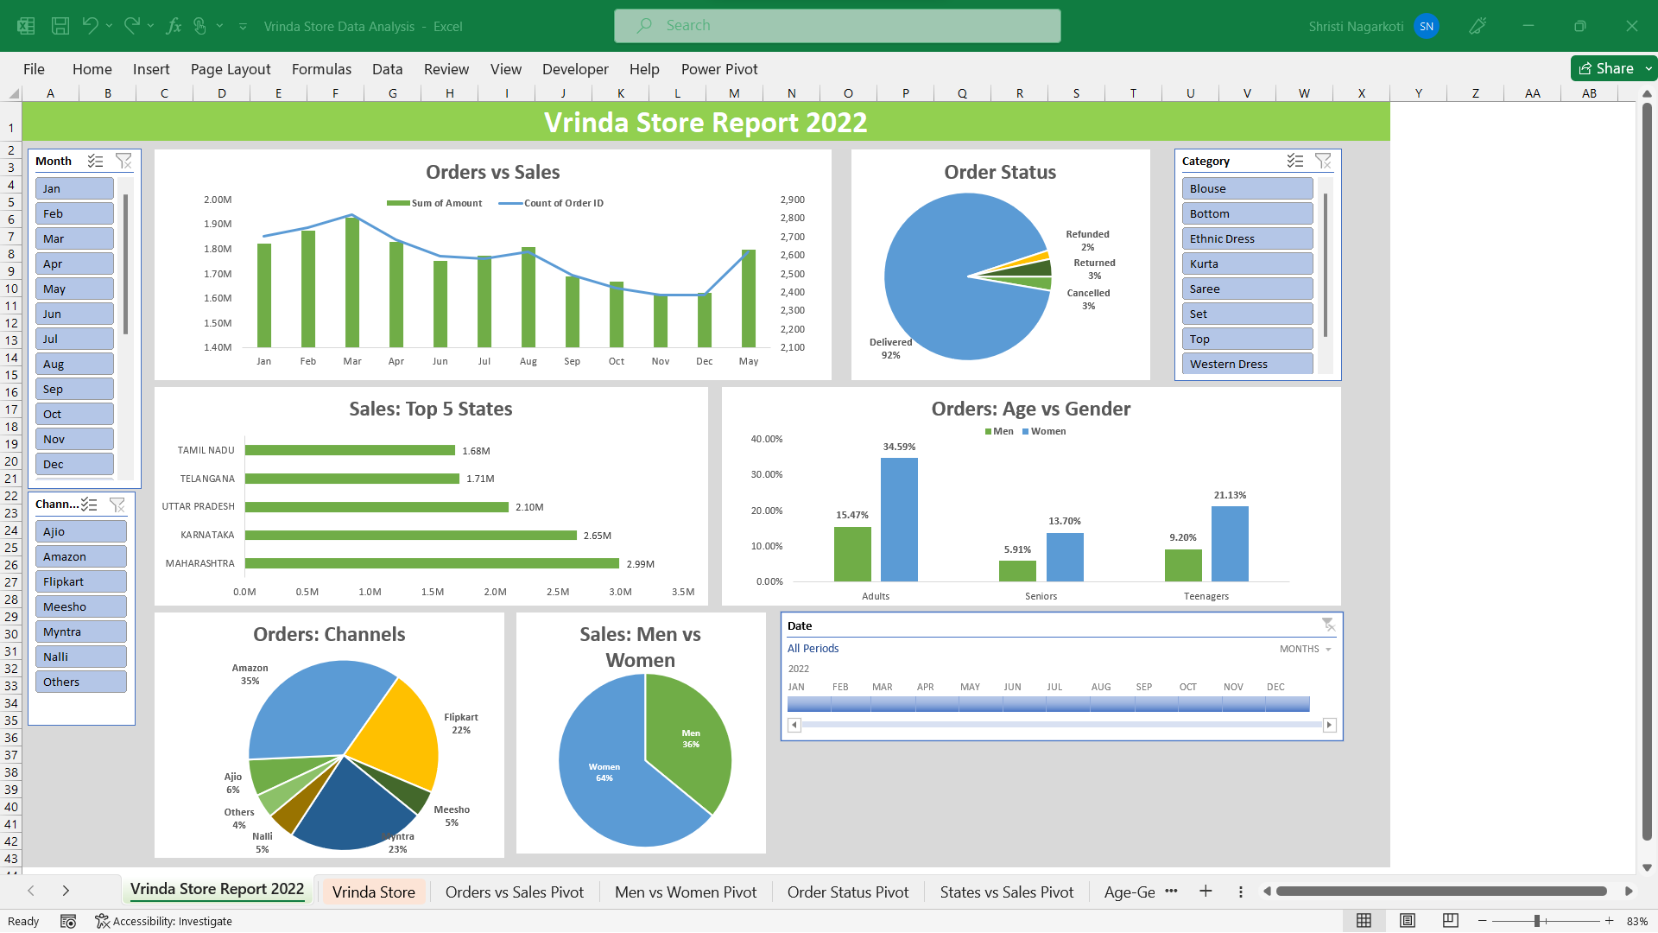
DYNAMIC DASHBOARD PREVIEW

Slide 7
BUSINESS CAMPAIGN Suggestions
To capitalize on the insights gained from our data analysis, we have formulated a set of actionable suggestions for business campaigns. These campaigns are designed to leverage the identified trends and opportunities to drive business growth for Vrinda Store.
Seasonal Promotions
Women-Centric Marketing
Engaging Senior Male Shoppers
Regional Expansion Initiatives
Targeted Online Marketing
Implementing these suggested campaigns can create a positive impact on sales, customer engagement, and brand visibility. By aligning marketing efforts with the analyzed insights, Vrinda Store can strengthen its competitive position and drive sustainable growth.

Slide 8
Key takeaways
Sales Performance Trends
CUSTOMER SEGMENTATION
Regional dynamics
Channel insights
Identifying peak and low sales months enables strategic planning to optimize revenue.
Targeted marketing campaigns for underrepresented segments, such as senior male shoppers, can unlock growth opportunities.
Tailoring strategies to specific regions can optimize sales and market penetration.
Amazon, Myntra, Flipkart are the top channels for customer orders, emphasizing the significance of online marketing and partnerships.

Slide 9
CONCLUSION
Through rigorous data cleaning, processing, and analysis, we have gained invaluable insights into Vrinda Store's sales performance and customer behavior. These insights empower the business to make informed decisions and shape effective strategies. By leveraging the identified trends, targeting specific customer segments, and expanding strategically, Vrinda Store can drive growth, enhance customer satisfaction, and solidify its position in the fashion e-commerce industry.

Slide 10

Shristi Nagarkoti
shristi228@gmail.com

